Slide 1
Computer Networks
Lecture: Data Link Layer

Slide 2
Data Link Layer Design Issues
Services Provided to the Network Layer
Framing
Error Control
Flow Control

Slide 3
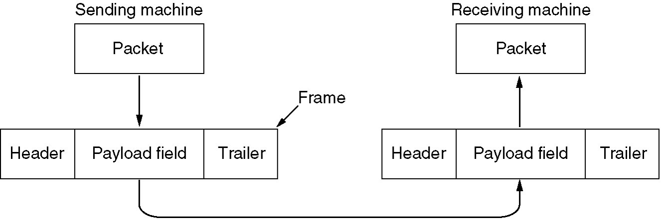
Functions of the Data Link Layer
Provide service interface to the network layer
Framing provides a way for a sender to transmit a set of bits that are meaningful to the receiver.
Dealing with transmission errors
Regulating data flow
Slow receivers not swamped by fast senders

Slide 4
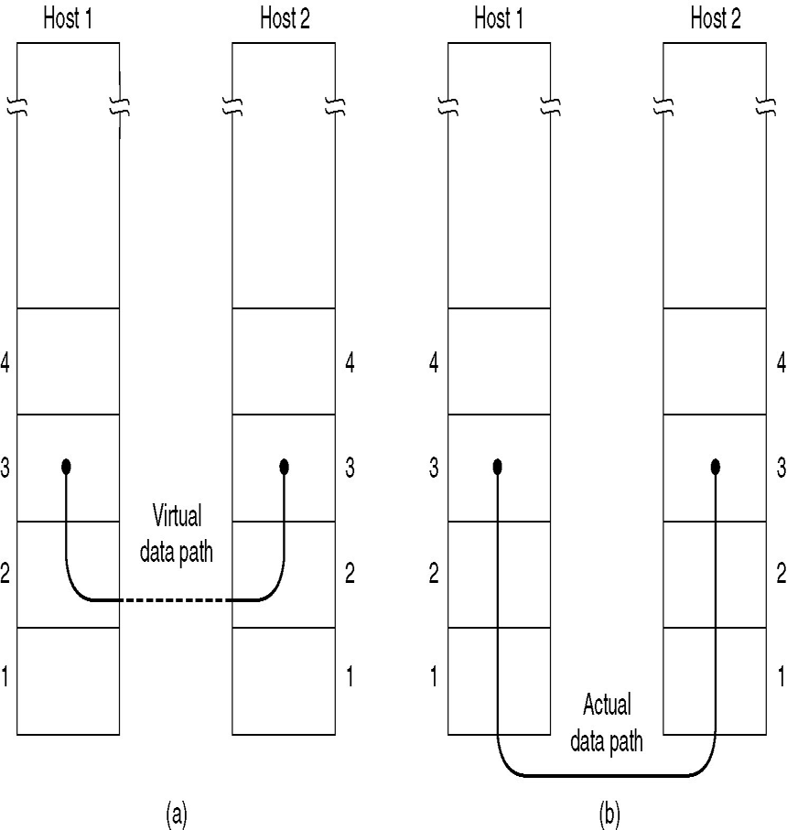
Services Provided to Network Layer
Services Provided to the Network Layer - Recall that lower layers provide services to higher layers that implement the actual physical path.
The higher layer on the source communicates to the same layer on the destination via a virtual path created by the lower layers.

Slide 5
Types of services provided to the Network Layer
Unacknowledged Connectionless service
Acknowledged Connectionless service
Acknowledged Connection-Oriented service

Slide 6
Unacknowledged Connectionless service
Source machine send independent frames to the destination machine without having the destination machine acknowledge them
No logical connection is established beforehand and released afterward
If a frame is lost due to noise on the line, no attempt is made to detect the loss or recover from it in the data link layer.
Appropriate for voice, where delay is worse than bad data.

Slide 7
Acknowledged Connectionless service
There is no logical connections between sender and receiver
Each frame sent is individually acknowledged. Hence the sender knows whether the frame has arrived correctly or not.
If it is not arrived within a specified time interval, it can be send again.
This service is useful over unreliable channels such as wireless system.
Adding ack in the DLL rather than in the NL is just an optimization and not a requirement.

Slide 8
Acknowledged Connection-oriented service
Most reliable
Source and destination machine establishes a connection before any data are sent
Guaranteed service –
Each frame sent is indeed received
Each frame is received exactly once
Frames are received in order

Slide 9
Framing
Framing is a function of the data link layer.
It provides a way for a sender to transmit a set of bits that are meaningful to the receiver.
Ethernet, token ring, frame relay, and other data link layer technologies have their own frame structures.
Frames have headers that contain information such as error-checking codes.

Slide 10
There are four different types of framing, each of which provides a way for the sender to tell the receiver where the block of data begins and ends:
Byte Count
Flag bytes with byte stuffing
Flag bytes with bit stuffing
Physical Layer Violation

Slide 11
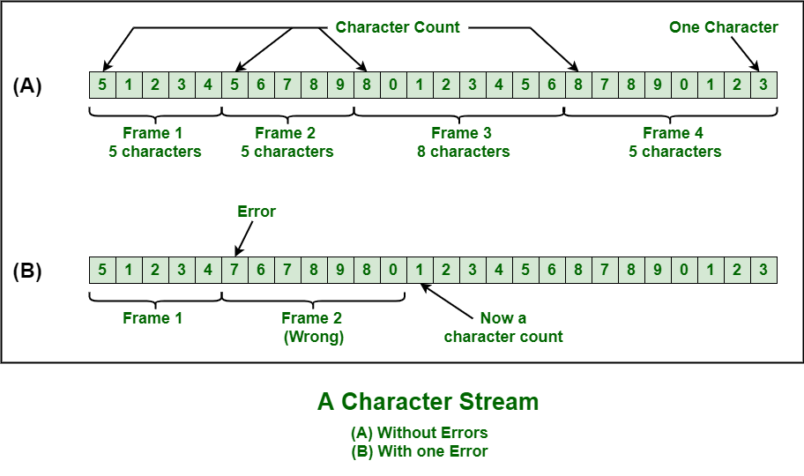
Byte Count
This framing method uses a field in the header to specify the number of bytes in the frame.
When the data link layer at the destination sees the byte count, it knows how many bytes follow and hence whare the end of the frame is.
What if the count is garbled..?

Slide 12
Problem with byte count
Even if with checksum, the receiver knows that the frame is bad there is no way to tell where the next frame starts.
Asking for retransmission doesn’t help either because the start of the retransmitted frame is not known.
Rarely used method

Slide 13
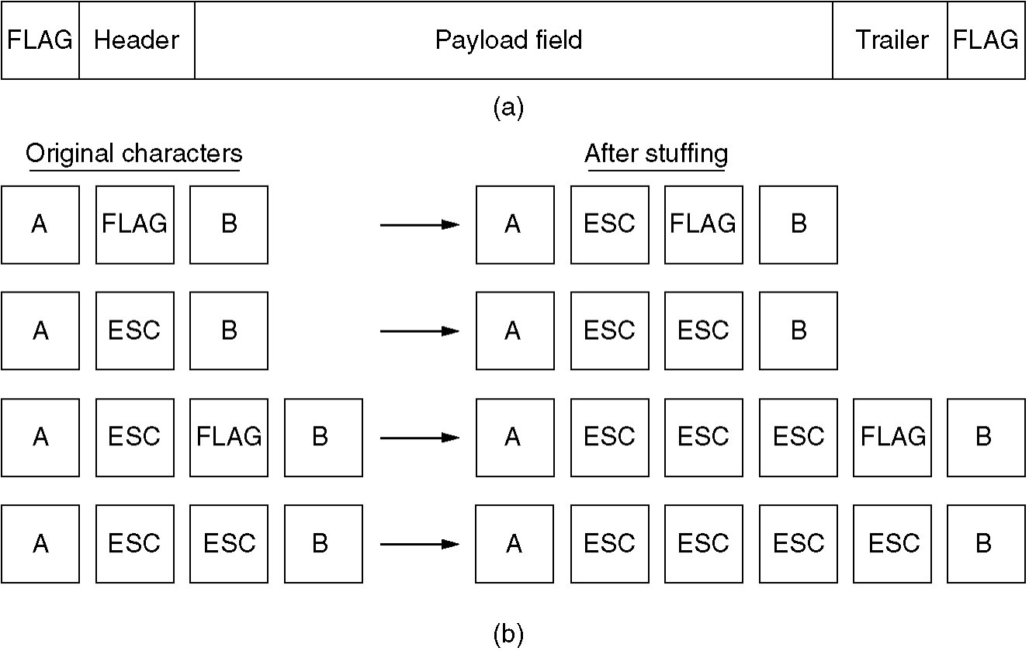
Framing with byte stuffing
Each frame starts and end with special bytes called flag byte.
Two consecutive flag byte indicates the end of one frame and start of the other frame.
If the receiver looses synchronization it can just search for two flag bytes to find the end of the current frame and start of the next frame

Slide 14
Problem in byte stuffing
Flag byte can occur in data
To solve this, to solve this insert a special character called ESC(escape byte) at the sender's data link layer just before each " accidental" flag byte in the data.
Hence the framing flag byte can be distinguished from one in the data by the absence or presence of ESC before it.
The data link layer at the receiving end removes the escape bytes before giving it to the network layer.
This technique is known as byte stuffing
The data become so bulky

Slide 15
Framing with bit stuffing
Bit stuffing is also known as bit-oriented framing or bit-oriented approach.
Framing done at the bit level.
Frames can contain an arbitrary number of bits made up of units of any size
Each frame begins with a special bit pattern, 01111110 or 0x7E in hexadecimal
Whenever the sender's data link layer encounters five consecutive 1's in the data, it automatically stuffs a 0 bit into the outgoing bit stream.

Slide 16
When the receiver sees five consecutive incoming 1 by, followed by a 0 bit, it automatically destuffs the 0 bit
The boundary between two frames can be recognized by the flag pattern.
If the receiver loses track of where it is, scan the input for flag sequence, since they only occur at the frame boundaries and never within the data
The data become so bulky

Slide 17
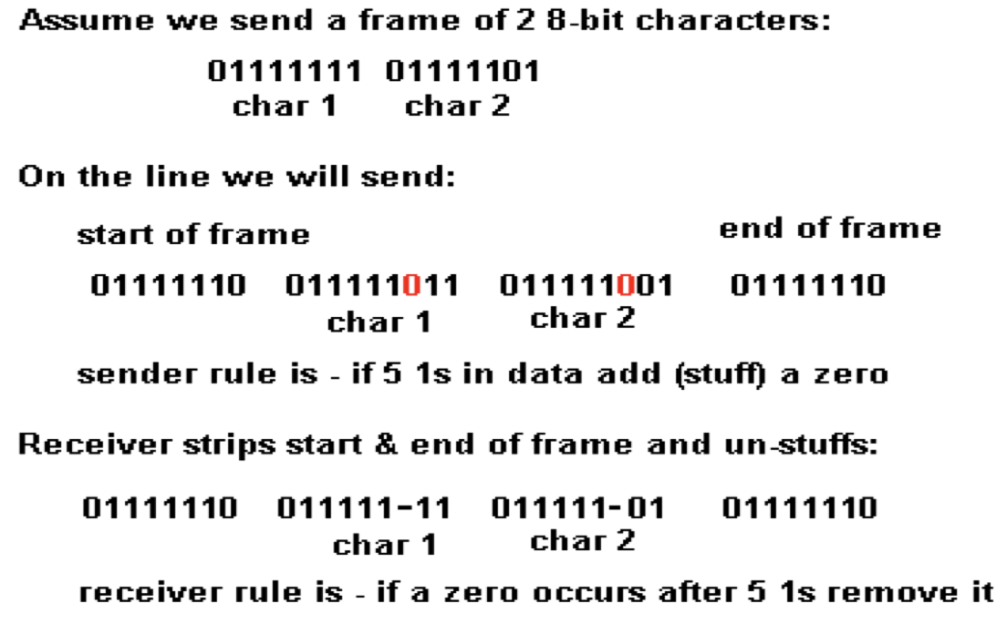

Slide 18
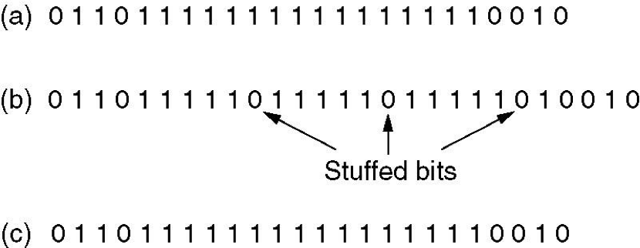
Bit stuffing
(a) The original data.
(b) The data as they appear on the line.
(c) The data as they are stored in receiver’s memory after destuffing.

Slide 19
Physical Layer Coding Violations
Encoding on physical medium
Framing by invalid physical code
Use some code that does not represent 0 nor 1
Example
Manchester encoding in 802 LAN standard
4B/5B line code
Combination of approaches is possible
E.g., character count + one other method
Preamble in Ethernet followed by length

Slide 20
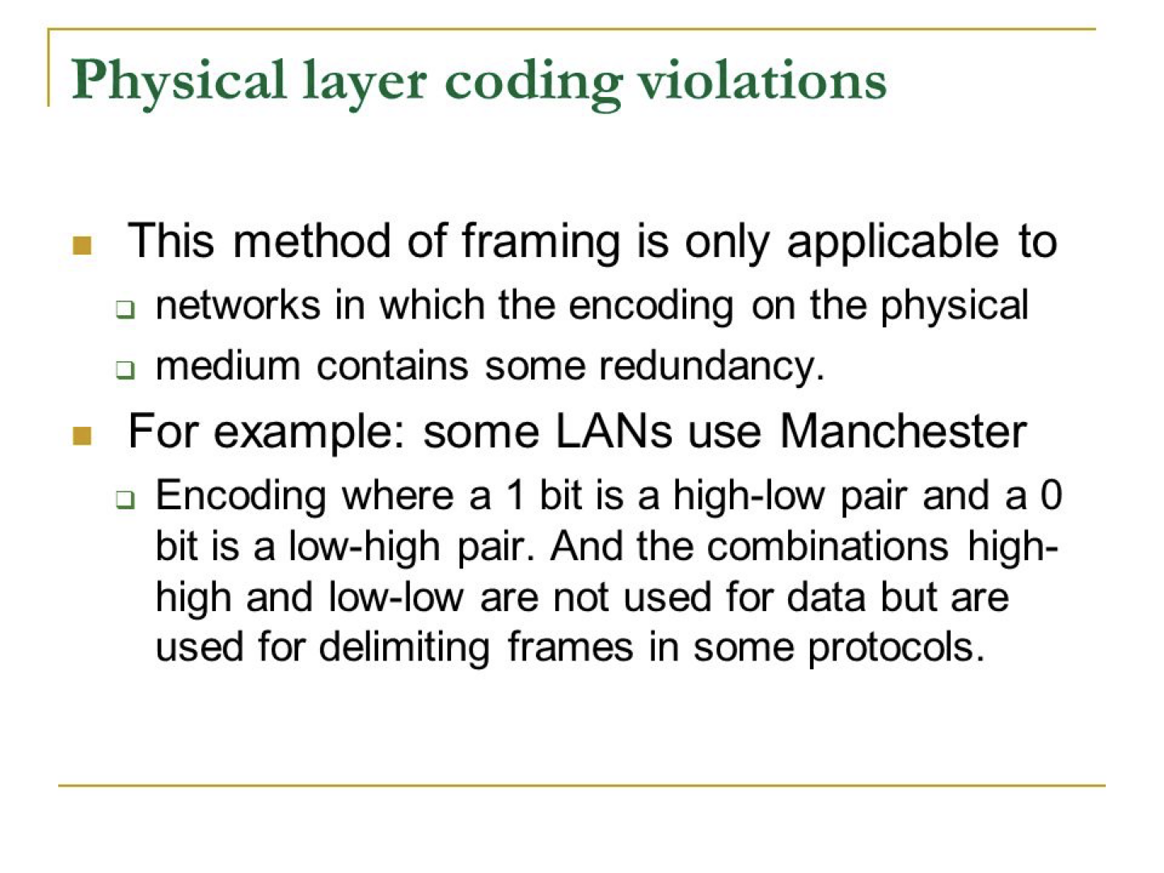

Slide 21
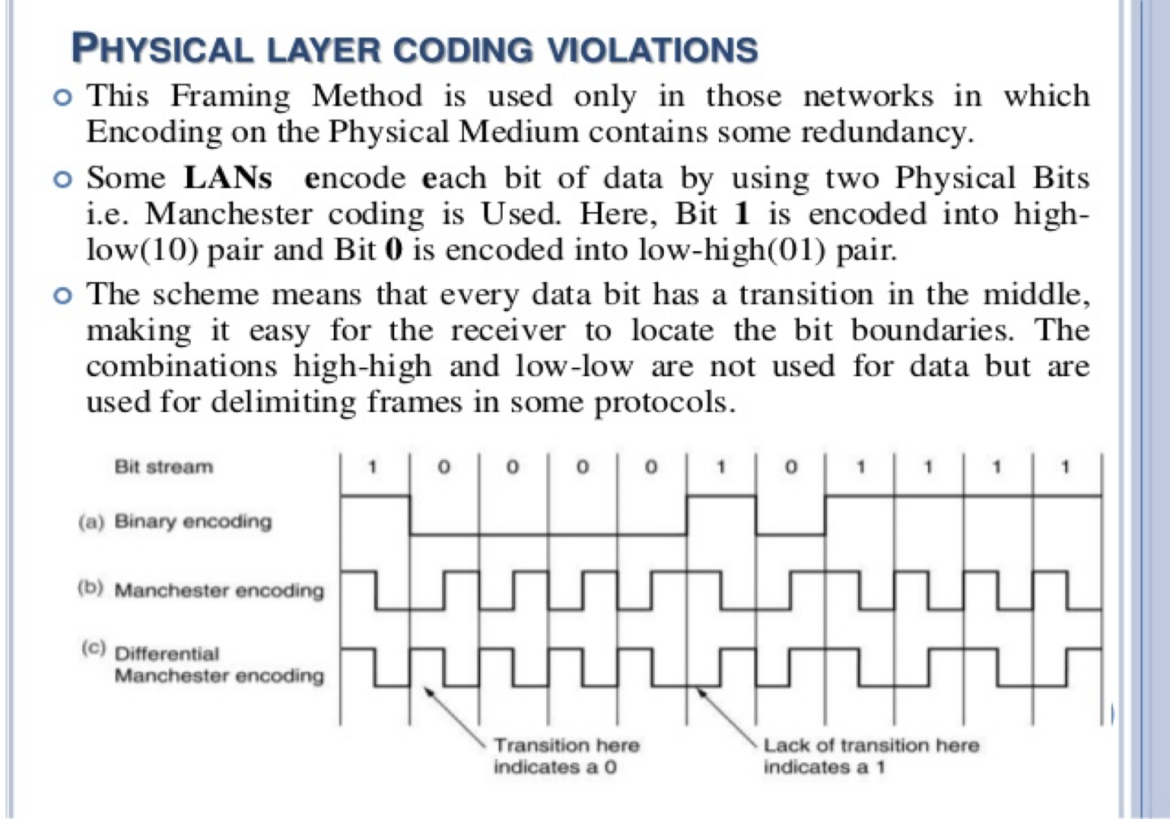

Slide 22
Error Control
Positive and Negative feedback
Timers : what happens when a frame completely vanishes : receiver neither sends a +ack nor –ack … then timer comes to help.
It may result in a frame being sent more than once and received more than once :
solution : assign sequence numbers to frames

Slide 23
Error Detection and Correction
In some cases it is sufficient to detect an error and in some, it requires the errors to be corrected also. For example
On a reliable medium : ED is sufficient where the error rate is low and asking for retransmission after ED would work efficiently
In contrast, on an unreliable medium : Retransmission after ED may result in another error and still another and so on. Hence EC is desirable.

Slide 24
Error detecting code
Parity
Checksum
Polynomial code or CRC( Cyclic Redundancy Check )

Slide 25


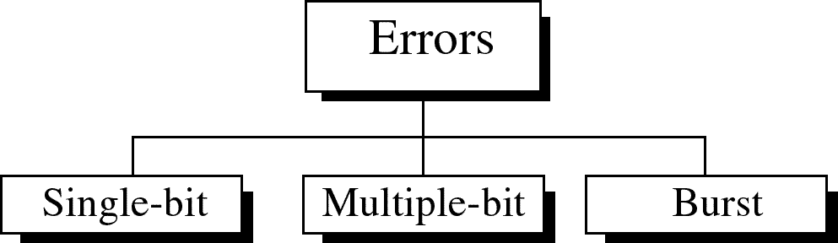
Type of Errors

Slide 26
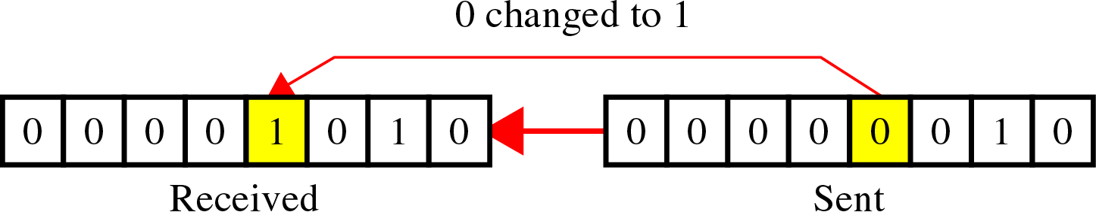
Type of Errors
Single-Bit Error
~ is when only one bit in the data unit has changed
Single bit errors are the least likely type of errors in serial data transmission because the noise must have a very short duration which is very rare. However this kind of errors can happen in parallel transmission.

Slide 27
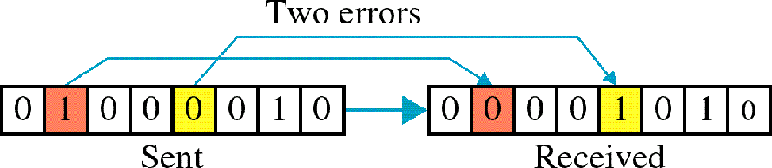
Type of Errors
Multiple-Bit Error
~ is when two or more nonconsecutive bits in the data unit have changed

Slide 28
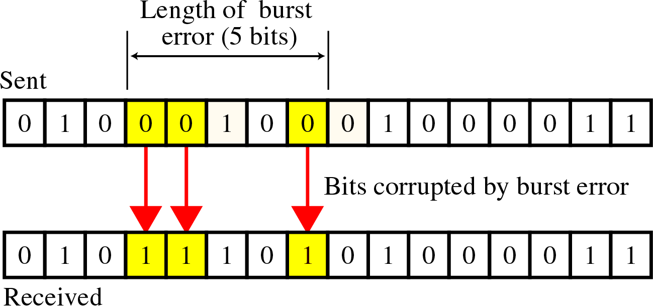
Type of Errors
Burst Error
~ means that 2 or more consecutive bits in the data unit have changed

Slide 29


The term burst error means that two or more bits in the data unit have changed from 1 to 0 or from 0 to 1.
Burst errors does not necessarily mean that the errors occur in consecutive bits, the length of the burst is measured from the first corrupted bit to the last corrupted bit. Some bits in between may not have been corrupted.
Burst error is most likely to happen in serial transmission since the duration of noise is normally longer than the duration of a bit.
The number of bits affected depends on the data rate and duration of noise.

Slide 30

Error detection
Error detection means to decide whether the received data is correct or not without having a copy of the original message.
Error detection uses the concept of redundancy, which means adding extra bits for detecting errors at the destination.

Slide 31
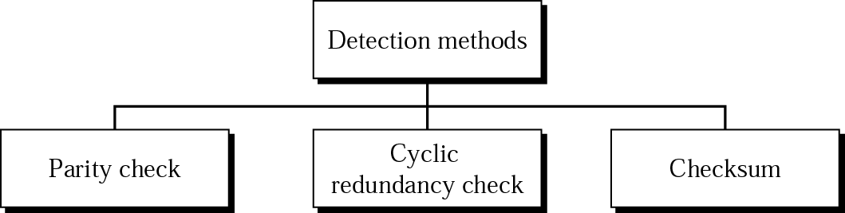
Detection methods

Slide 32
Parity
Value of parity bit is such that character has even (even parity) or odd (odd parity) number of ones
Even number of bit errors goes undetected
Simple Parity
Longitudinal Redundancy Check/Vertical Redundancy Check (LRC/VRC)

Slide 33
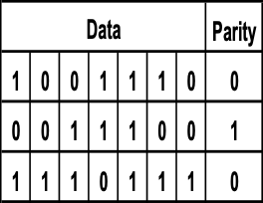
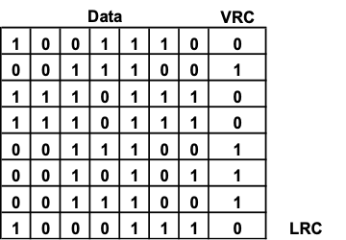
Parity Examples - Using Even Parity
Even Parity of 1’s
LRC/VRC

Slide 34
Parity Checks
Simple parity - If performing even parity, add a parity bit such that an even number of 1s are maintained.
If performing odd parity, add a parity bit such that an odd number of 1s are maintained.
For example, if the character 1001010 is to be sent, using even parity, a parity bit = 1 would be added to the character.
If the character 1001011 is to be sent, using even parity, a parity bit = 0 would be added to the character.

Slide 35
Parity Checks
What happens if the character 10010101 (parity bit is the last bit) and the first two 0s accidentally become two 1s?
Thus, the following character is received: 11110101.
Will there be a parity error?
Problem: Simple parity only detects odd numbers of bits in error (50%)

Slide 36
Parity Checks
Longitudinal parity adds a parity bit to each character then adds a row of parity bits after a block of characters.
The row of parity bits is actually a parity bit for each “column” of characters.
The row parity bits plus the column parity bits add a great amount of redundancy to a block of characters.

Slide 37
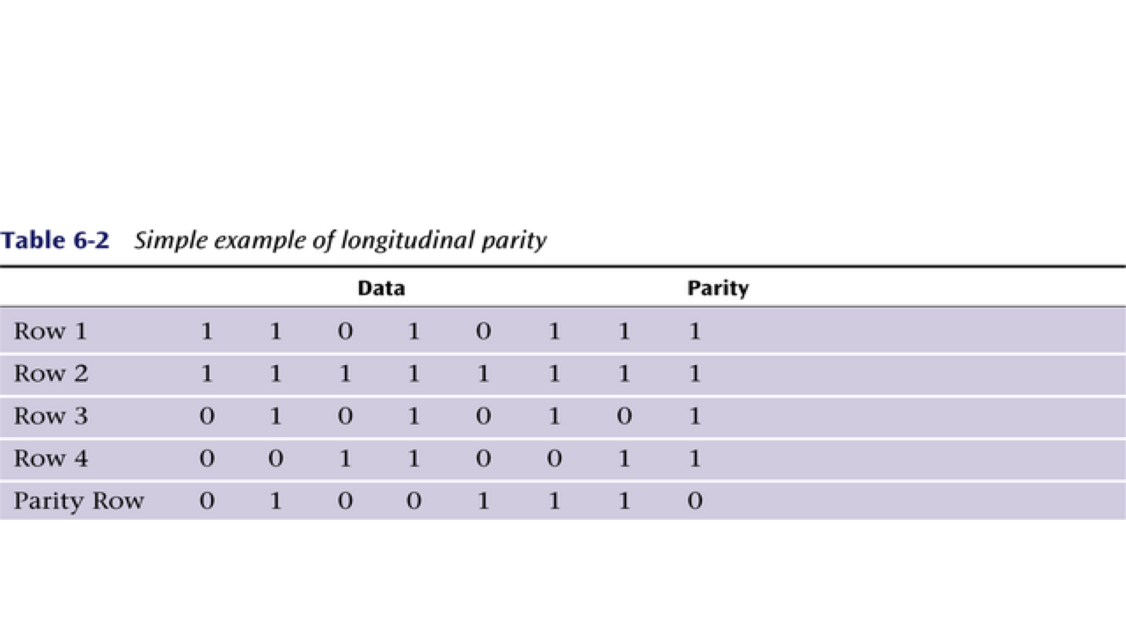

Slide 38
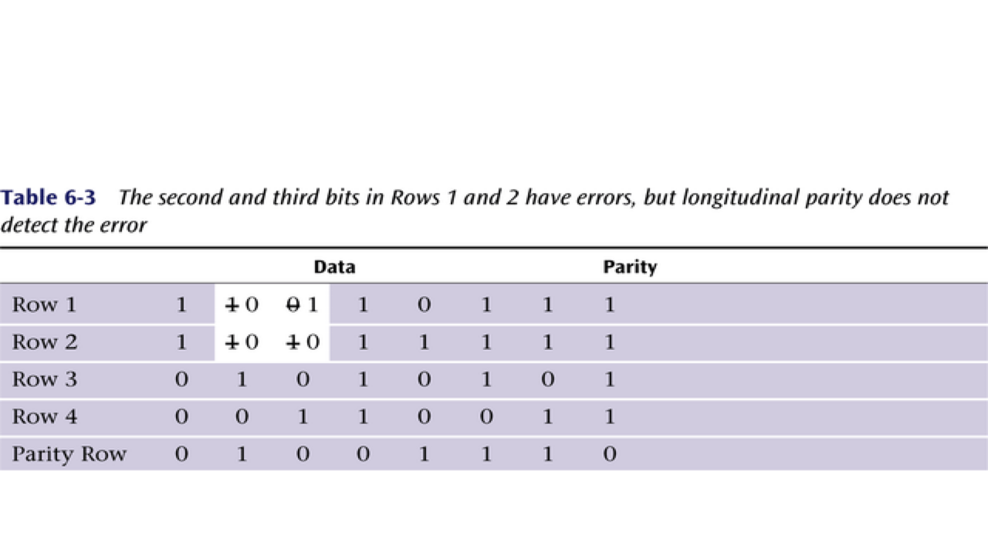

Slide 39
Parity Checks
Both simple parity and longitudinal parity do not catch all errors.
Simple parity only catches odd numbers of bit errors (50% of all errors)
Longitudinal parity is better at catching errors but requires too many check bits added to a block of data.
As such, these methods are not that often used. However, a parity bit exists in 1 byte of data.
We need a better error detection method. What about cyclic redundancy checksum?

Slide 40
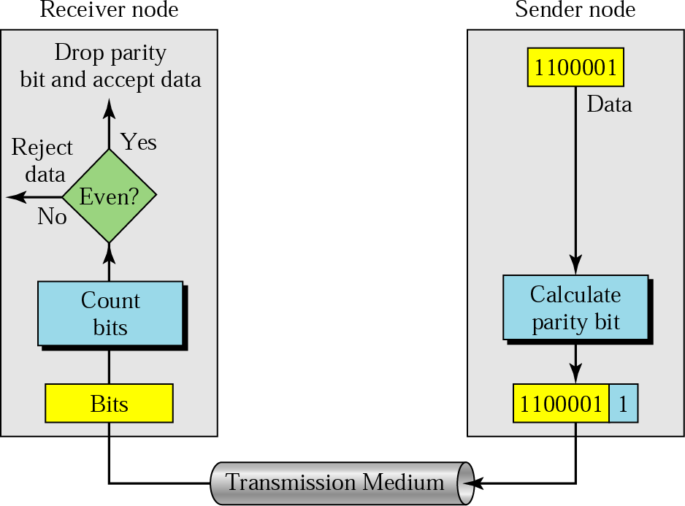
Parity Check
🞑 A parity bit is added to every data unit so that the total number of 1s(including the parity bit) becomes even for even-parity check or odd for odd-parity check
🞑 Simple parity check

Slide 41



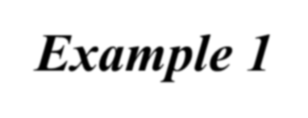
Detection -examples
Example 1
Suppose the sender wants to send the word world. In ASCII the five characters are coded as
1110111 1101111 1110010 1101100 1100100
The following shows the actual bits sent
11101110 11011110 11100100 11011000 11001001

Slide 42



Detection – examples
Now suppose the word world in Example 1 is received by the receiver without being corrupted in transmission.
11101110 11011110 11100100 11011000
11001001
The receiver counts the 1s in each character and comes up with even numbers (6, 6, 4, 4, 4). The data are accepted.

Slide 43
Detection – examples
Now suppose the word world in Example 1 is corrupted during transmission.
11111110 11011110 11101100 11011000
11001001
The receiver counts the 1s in each character and comes up with even and odd numbers (7, 6, 5, 4, 4). The receiver knows that the data are corrupted, discards them, and asks for retransmission.

Slide 44
the simplest form of error detection is the use of a single parity bit.
In an even parity scheme, the sender simply includes one additional bit and chooses its value such that the total number of 1s in the d + 1 bits (the original information plus a parity bit) is even. For odd parity schemes, the parity bit value is chosen such that there is an odd number of 1s.

Slide 45
Receiver operation is also simple with a single parity bit. The receiver need only count the number of 1s in the received d + 1 bits. If an odd number of 1-valued bits are found with an even parity scheme, the receiver knows that at least one bit error has occurred. More precisely, it knows that some odd number of bit errors have occurred.

Slide 46


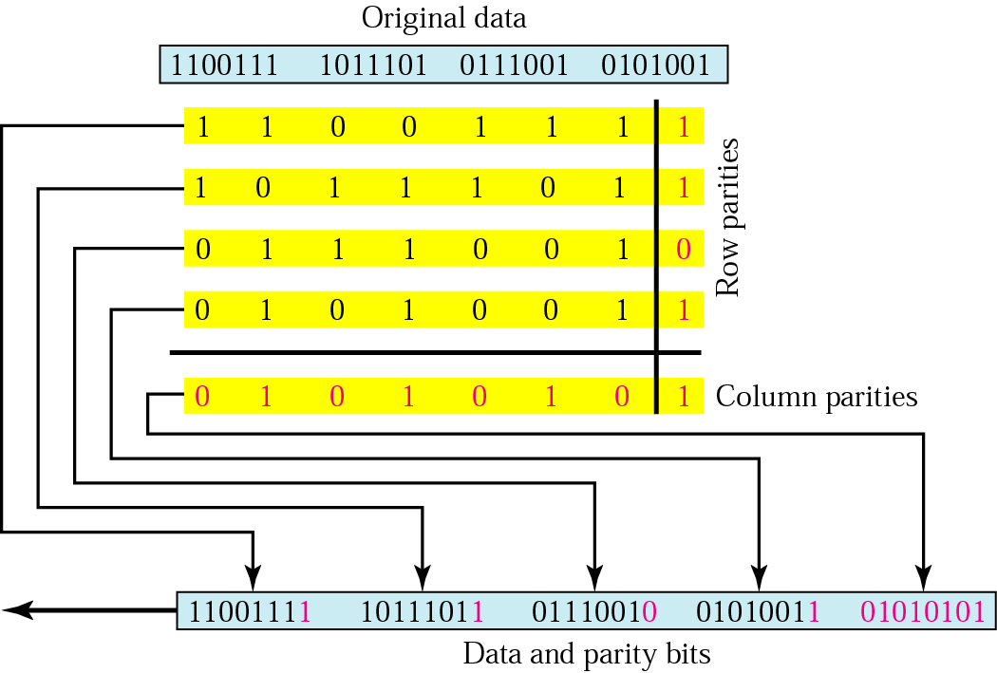
Two –Dimensional Parity Check

Slide 47
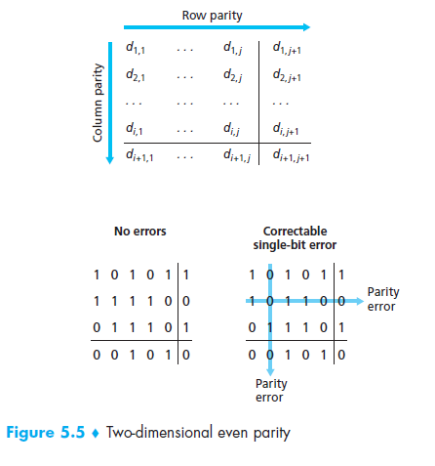

Slide 48
With this two-dimensional parity scheme, the parity of both the column and the row containing the flipped bit will be in error.
The receiver can thus not only detect the fact that a single bit error has occurred, but can use the column and row indices of the column and row with parity errors to actually identify the bit that was corrupted and correct that error.
The ability of the receiver to both detect and correct errors is known as forward error correction (FEC). These techniques are commonly used in audio storage and playback devices such as audio CDs.

Slide 49


Detection - example
Suppose the following block is sent:
10101001 00111001 11011101 11100111 10101010
However, it is hit by a burst noise of length 8, and some bits are corrupted.
10100011 10001001 11011101 11100111 10101010
When the receiver checks the parity bits, some of the bits do not follow the even-parity rule and the whole block is discarded.
10100011 10001001 11011101 11100111 10101010

Slide 50

Detection
Checksum
used by the higher layer protocols
is based on the concept of redundancy(VRC, LRC, CRC ….)

Slide 51
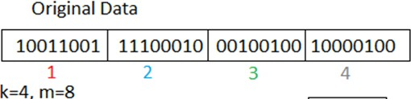
Checksum
In checksum error detection scheme, the data is divided into k segments each of m bits.
In the sender’s end the segments are added using 1’s complement arithmetic to get the sum. The sum is complemented to get the checksum.
The checksum segment is sent along with the data segments.
At the receiver’s end, all received segments are added using 1’s complement arithmetic to get the sum. The sum is complemented.
If the result is zero, the received data is accepted; otherwise discarded.

Slide 52
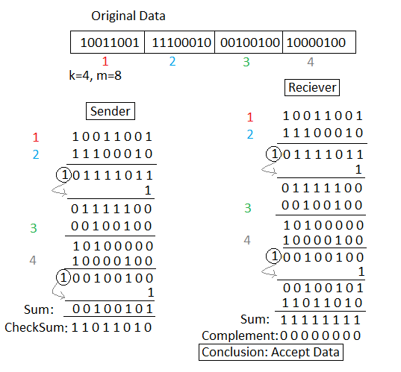

Slide 53
Cyclic Redundancy Check (CRC)
Cyclic Redundancy Check (CRC) is an error detection technique to detect changes to raw data and is used widely in today’s computer networks.
CRC codes are also known as polynomial codes, since it is possible to view the bit string to be sent as a polynomial.

Slide 54
Cyclic Redundancy Checksum (CRC)
The CRC error detection method treats the packet of data to be transmitted as a large polynomial.
The transmitter takes the message polynomial and using polynomial arithmetic, divides it by a given generating polynomial.
The quotient is discarded but the remainder is “attached” to the end of the message (remainder (mod) arithmetic)

Slide 55
Cyclic Redundancy Checksum
The message (with the remainder) is transmitted to the receiver.
The receiver divides the message and remainder by the same generating polynomial.
If a remainder not equal to zero results, there was an error during transmission.
If a remainder of zero results, there was no error during transmission.

Slide 56
Generator
The sender and receiver must first agree on an pattern, known as a generator, which we will denote as G.
If the generator is a polynomial, it must follow the following two properties:
It should not be divisible by x , because otherwise the last bit of the checksum would always be 0.
It should be divisible by x

Slide 57
The Technique
Suppose m is the number of bits of the CRC generator.
On Sender Side
Step 1
Append (m-1) number of zeroes to the data on the Least Significant Bit (LSB) (rightmost) side.
Divide it by the CRC Generator. (XOR operation is performed instead of Subtraction while dividing)

Slide 58
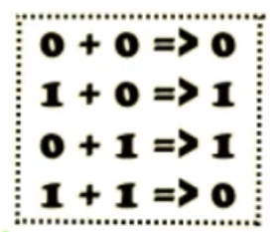
Step 2
The remainder from this division is added to the data generated earlier in Step 1.
This data is then sent to the destination

Slide 59
On Receiver Side
Step 1
Received data is again divided by the CRC generator.
Step 2
If remainder is zero No Error in Data
If remainder is not zero Data was altered somewhere in the network.

Slide 60
CRC generation at sender side
Step 1 : Find the length of the divisor "L"
Step 2 : Append "L-1" bits to the original message
Step 3: Perform binary division (XOR ) Operation
Step 4 : Remainder of the division = CRC

Slide 61
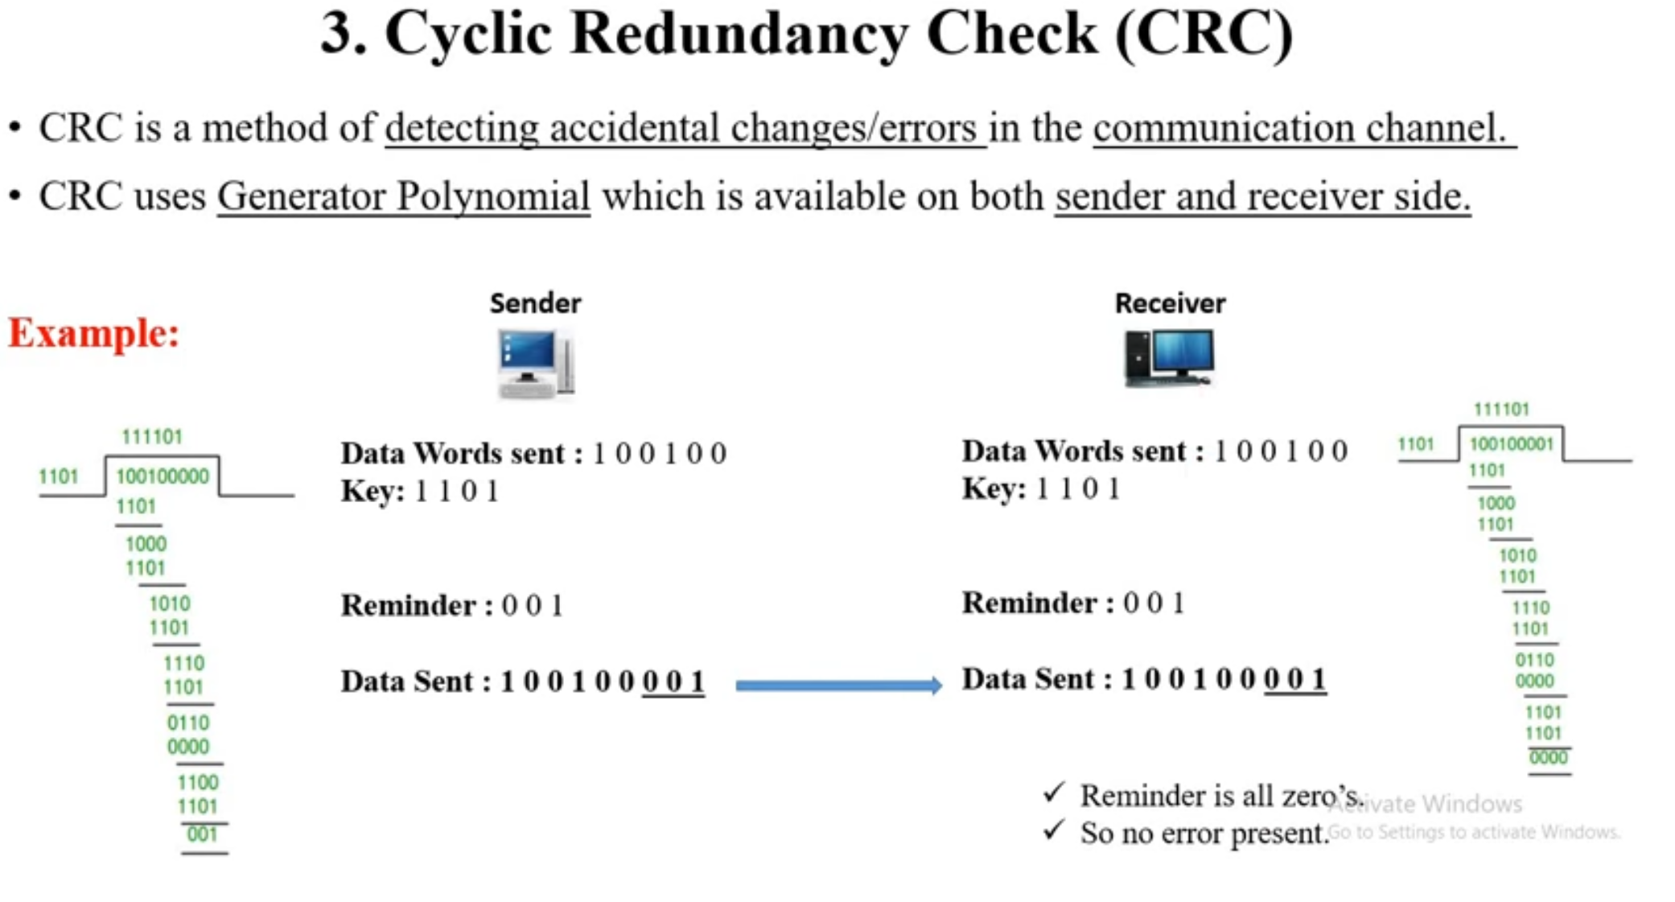

Slide 62
Example
In this example, we shall encode 14 bits of message.
Generator is the polynomial x³ + x + 1.
The polynomial is written in binary as the coefficients (1x³ + 0x² + 1x + 1).
In this case, the coefficients are 1, 0, 1 and 1.
Generator = 1011

Slide 63
Start with the message to be encoded:
11010011101100
We have m = 4, so we append 3 zeroes to the LSB side. 11010011101100000
Now we divide It by 1011

Slide 64
Remainder = 100
Now Add 100 to our original dividend.
11010011101100000
+ 100
____________________
11010011101100100

Slide 65

If generator is x³ + 1 and message to be sent is “CAT” . Find What Data is Sent. Further if 5th Bit is Changed show that the error can be detected.
C - 1000011
A - 1000001
T – 1010100
Generator = 1001
Append Three Zeroes
Solve with the same steps

Slide 66
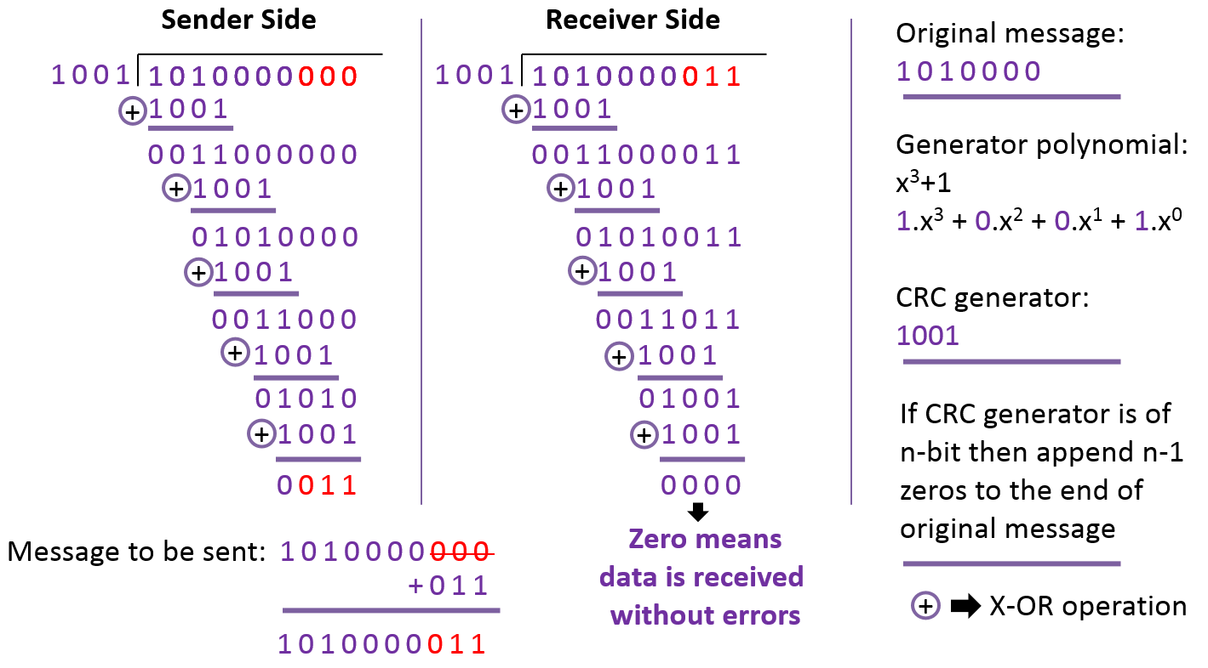

Slide 67
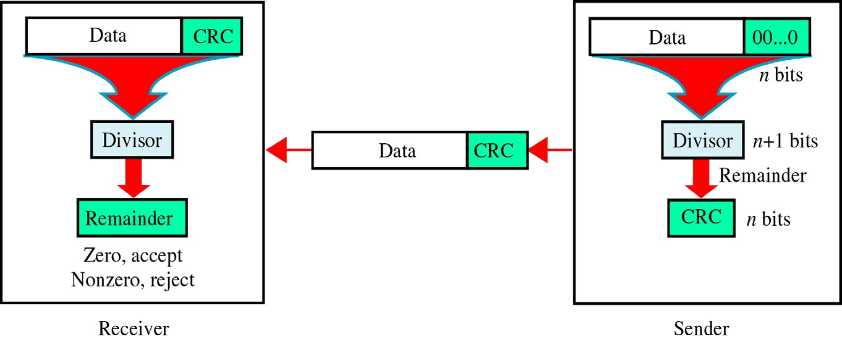
CRC(Cyclic Redundancy Check)
~ is based on binary division.

Slide 68
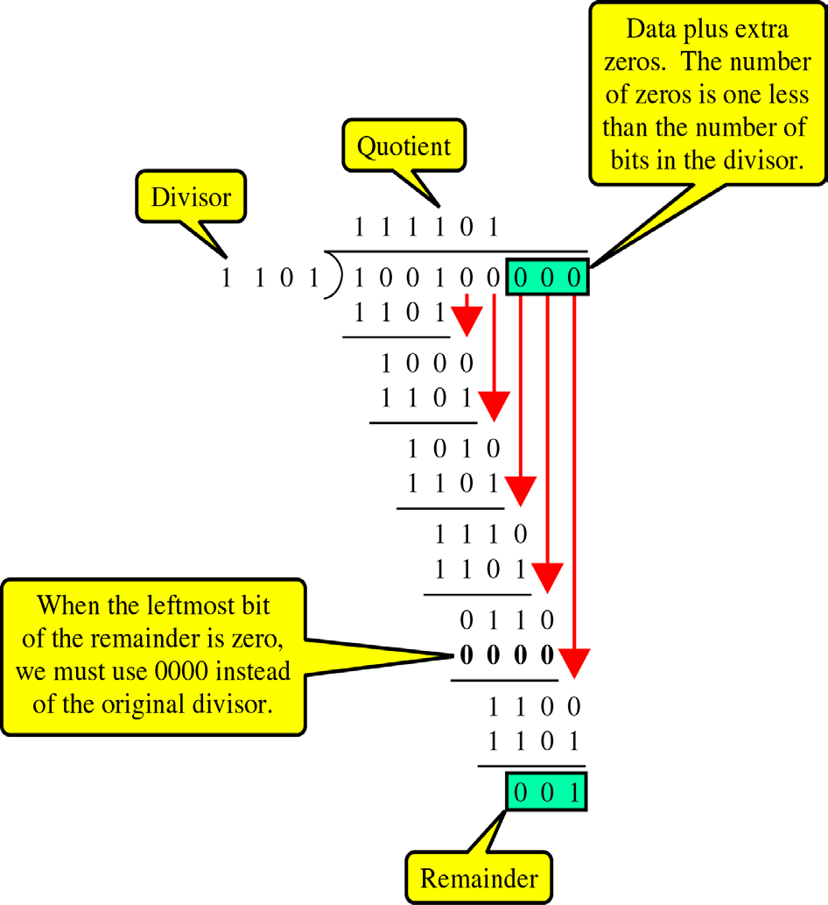
CRC generator
~ uses modular-2 division.

Slide 69

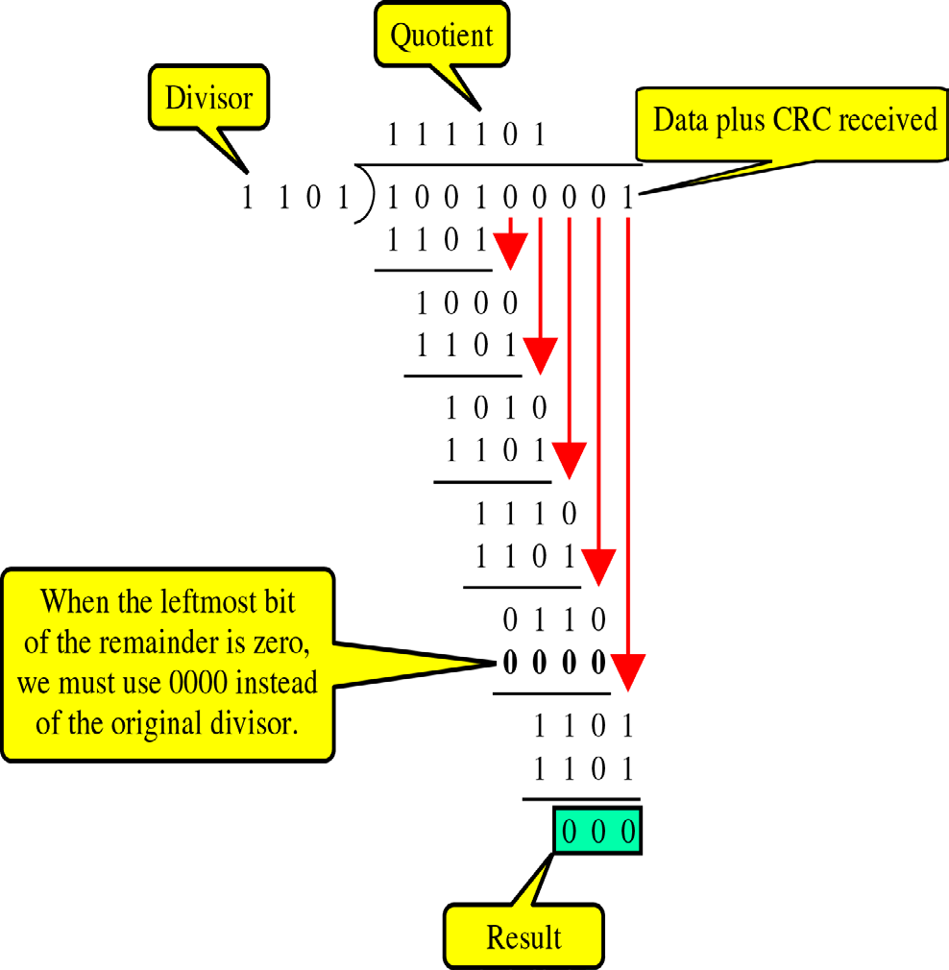
Detection
Binary Division in a
CRC Checker

Slide 70

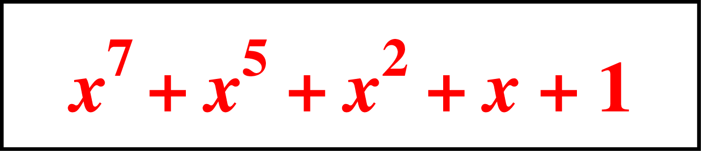
Detection(cont’d)
Polynomials
🞑 CRC generator(divisor) is most often represented not as a string of 1s and 0s, but as an algebraic polynomial.

Slide 71
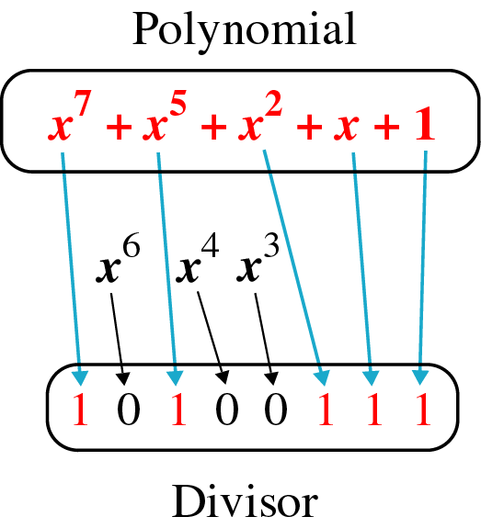
Detection(cont’d)
A polynomial representing a divisor

Slide 72
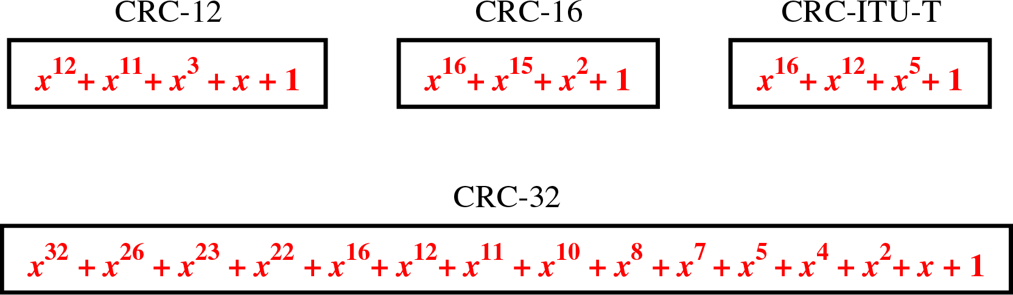
Detection(cont’d)
Standard polynomials

Slide 73
Using Polynomials
We can use a polynomial to represent a binary word.
Each bit from right to left is mapped onto a power term.
The rightmost bit represents the “0” power term. The bit next to it the “1” power term, etc.
If the bit is of value zero, the power term is deleted from the expression.

Slide 74
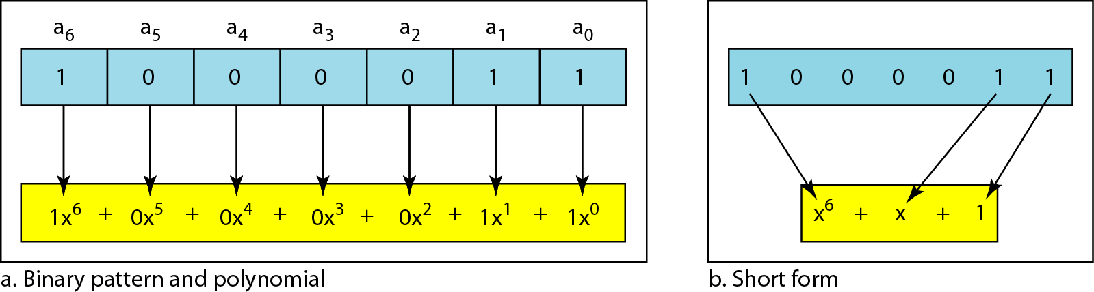
Figure 10.21 A polynomial to represent a binary word
10.

Slide 75
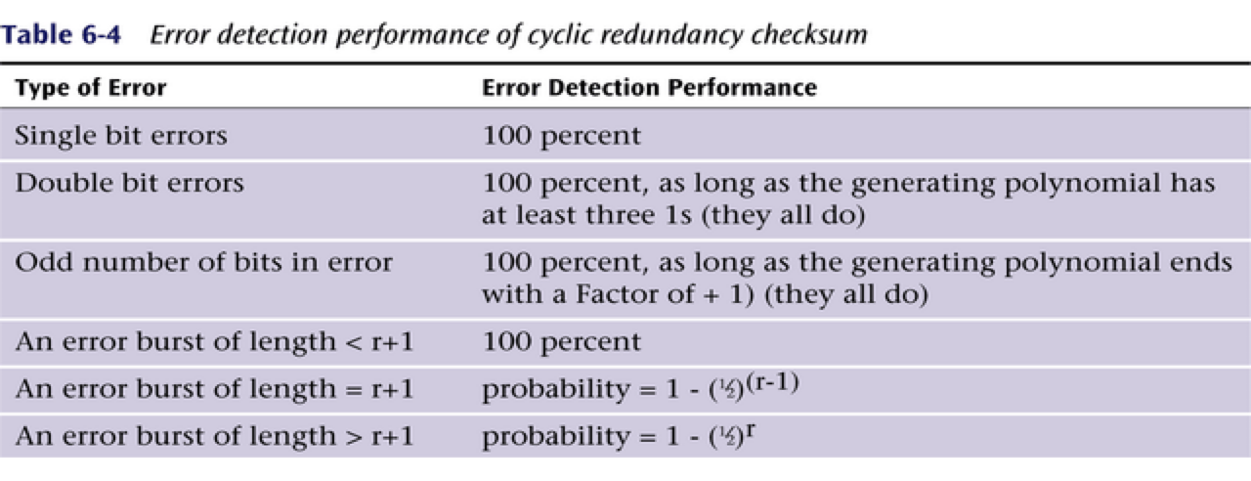

Slide 76
Application
When a codeword is received or read, a CRC-enabled device performs a CRC on the whole codeword and compares the resulting check value with an expected residue constant.
If the CRC check values do not match, then the block contains a data error
The device may take corrective action, such as rereading the block or requesting that it be sent again.

Slide 77
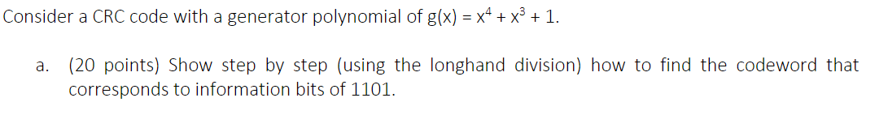
1.A bit stream 10011101 is transmitted using the standard CRC method. The generator polynomial is x³+1.
What is the actual bit string transmitted?
Suppose the third bit from the left is inverted during transmission. How will receiver detect this error?
2.Given the dataword 1010011110 and the divisor 10111, show the generation of the CRC codeword at the sender using binary division.
In a CRC error-detecting scheme, choose the generator polynomial as x⁴ + x + 1 (10011). Encode the 11-bit sequence: 10010011011
or
Given a CRC generator x⁴ + x + 1 (10011), calculate the CRC code for the message 10010011011. Show the steps clearly and derive the solution.

Slide 78
Example Question:
? : A bit stream 10101110 is transmitted using CRC. X³+1 is the generator polynomial used. Find out the codeword to be transmitted. Suppose during the transmission, due to some noise 5th bit from left of the code word flipped. Show how CRC detects the error.

Slide 79

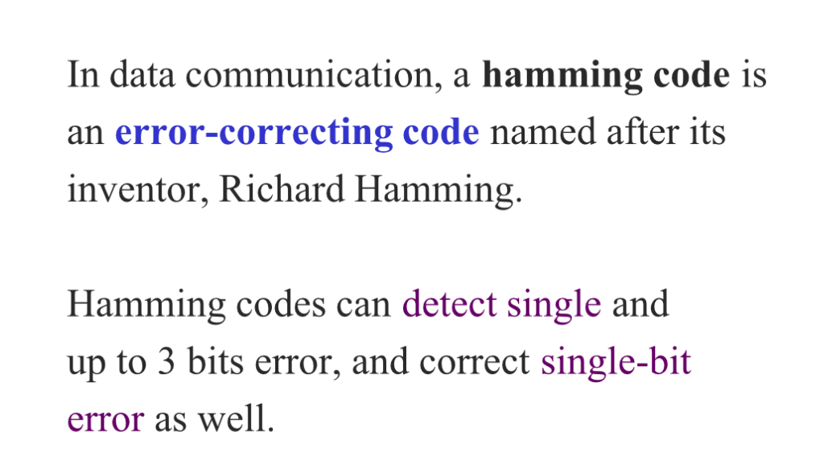

Slide 80
Hamming Codes
Hamming codes are error-correcting codes
These codes were originally designed with 𝒅_{𝒎𝒊𝒏}= 3, which means that they can detect up to two errors or correct one single error.
relationship between n and k in a Hamming code. We need to choose an integer m >= 3. The values of n and k are then calculated from mas n = 2^{m} -1 and k = n - m. The number of check bits r =m.
For example, if m =3, then n =7 and k = 4. This is a Hamming code C(7, 4) with 𝒅_{𝒎𝒊𝒏} =3.

Slide 81
Steps
Steps includes:
1) Calculate number of redundant bits.
2) Positioning the redundant bits.
3) Calculate the values of each redundant bits
2^{r} ≥d+r+1 ; r: no: of redundant bits
d: no: of data bits.
﻿﻿Powers of two 1,2,4, 8...
﻿﻿Even Parity / Odd Parity.

Slide 82
Hamming Code Structure
All the bit positions that are power of 2 are marked as parity bits (1,2,4,8,…..) and other bits are for data.
Eg: 7 bit hamming code
D7 | D6 | D5 | P4 | D3 | P2 | P1
Parity bit values :
Eg: 1101
D7 D6 D5
P4 D3
P2 P1
1 | 1 | 0 | ? | 1 | ? | ?

Slide 83
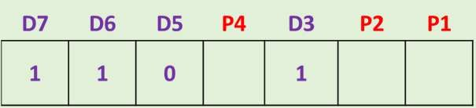
P1 : check 1 bit & skip 1bit ( 1,3,5,7,9,……)
P2 : check 2 bit & skip 2 bit ( 2,3,6,7,10,11,…)
P4 : check 4 bit & skip 4 bit (4,5,6,7,12,13,14,15,……)
P1 D3 D5 D7 P2 D3 D6 D7 P4 D5 D6 D7
P1 101
P2 111
P4 011
P1 = 0
P2 =1
P4 = 0
1 | 1 | 0 | 0 | 1 | 1 | 0

Slide 84
DETECTING & CORRECTING ERROR
Suppose the receiver receives the data 1011011
1 0 1 1 0 1 1
Step 1: analyze bit 1,3,5,7 (for P1) = P1 D3 D5 D7 = 1011 Odd number of 1s. So error exist and we put P1=1
Step 2: analyze bit 2,3,6,7 (for P2) = P2 D3 D6 D7 = 1001 even number of 1s. So no error and we put P2=0
Step 3: analyze bit 4,5,6,7 (for P4) = P4 D5 D6 D7 = 1101 Odd number of 1s. So error exist and we put P4=1

Slide 85
Correcting Error
P4 P2 P1
Error word E =
Decimal value of the error E = 5 which shows that the 5th bit is in error.
So we write the correct word by simply inverting only the 5th bit
1 | 0 | 1
1 0 0 1 0 1 1

Slide 86
In a CRC error-detecting scheme, choose the generator polynomial as x⁴ + x + 1 (10011). Encode the 11-bit sequence: 10010011011
Given a CRC generator x⁴ + x + 1 (10011), calculate the CRC code for the message 10010011011. Show the steps clearly and derive the solution.
Justify answer using CRC for divisor: 1101 dividend: 100100
The data bit to be transmitted is 1011010, to be solved using the hamming code method.
Encode a binary word 11001 into the even parity hamming code.
Let us assume the even parity hamming code 111001101 is transmitted and the received code is 110001101). Now from the received code, let us detect and correct the error.
The message 11001001 is to be transmitted using CRC polynomial x*+1 to protect it from errors. Find the message that should be transmitted .
Construct the even parity Hamming code word for a data byte 1001101.

